Slide 1
Module 5 Guided Lab - Creating an Amazon RDS Database
Made for Professor Lanham A. by Amrit Singh

Slide 2
AGENDA
Accessing the AWS management console
Task 1 : Creating an Amazon RDS database
Task 2 : Configuring web application communication with a database instance

Slide 3
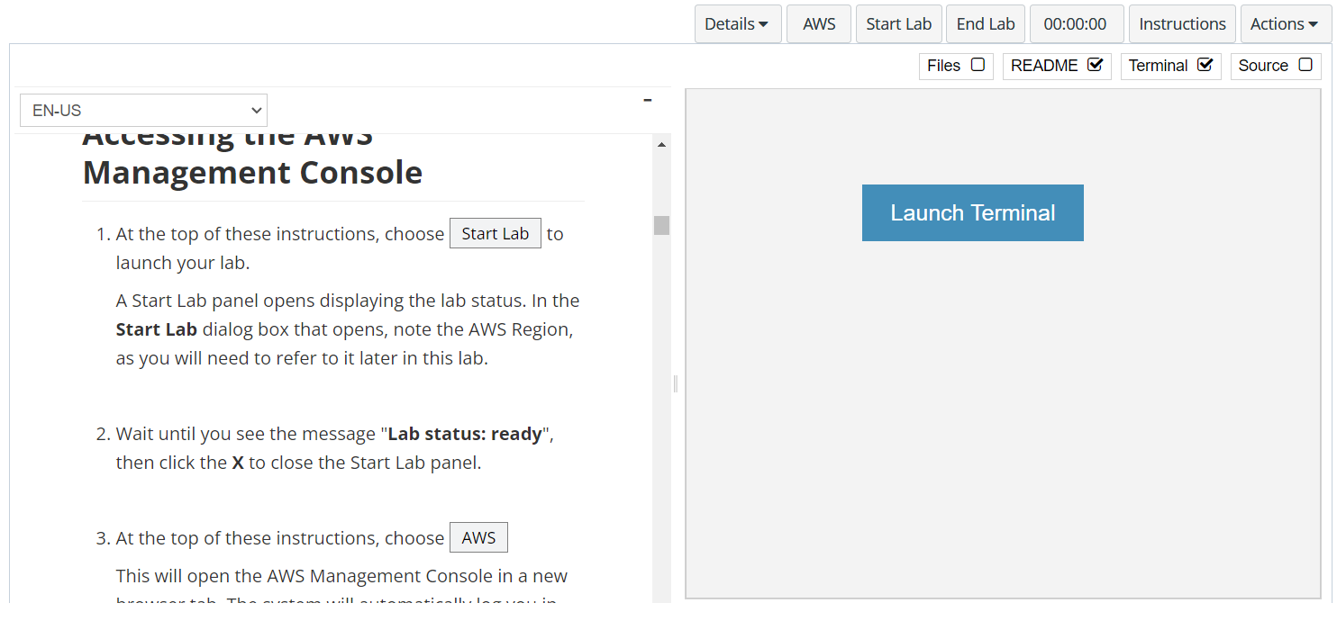
In aws labs click on start lab

Slide 4
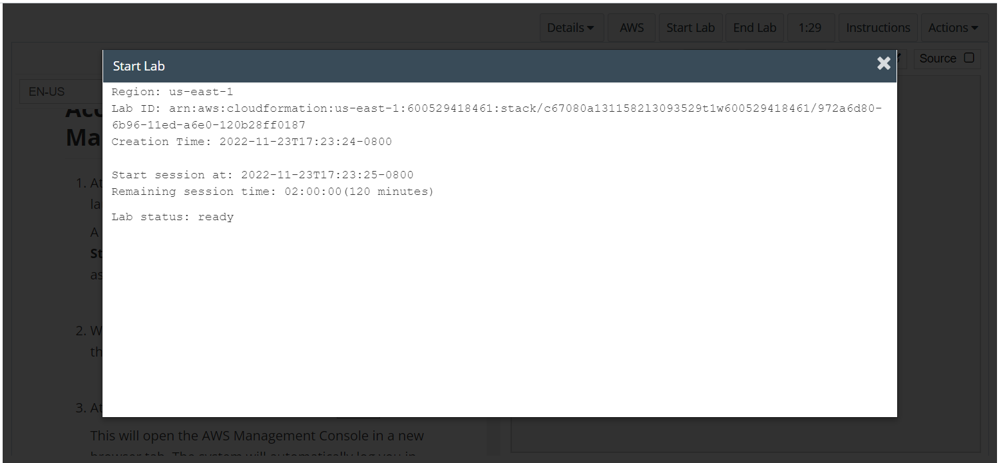
Wait to see lab ready status in the window then press x and click on aws to launch console

Slide 5
Task 1 : Creating an Amazon RDS database

Slide 6
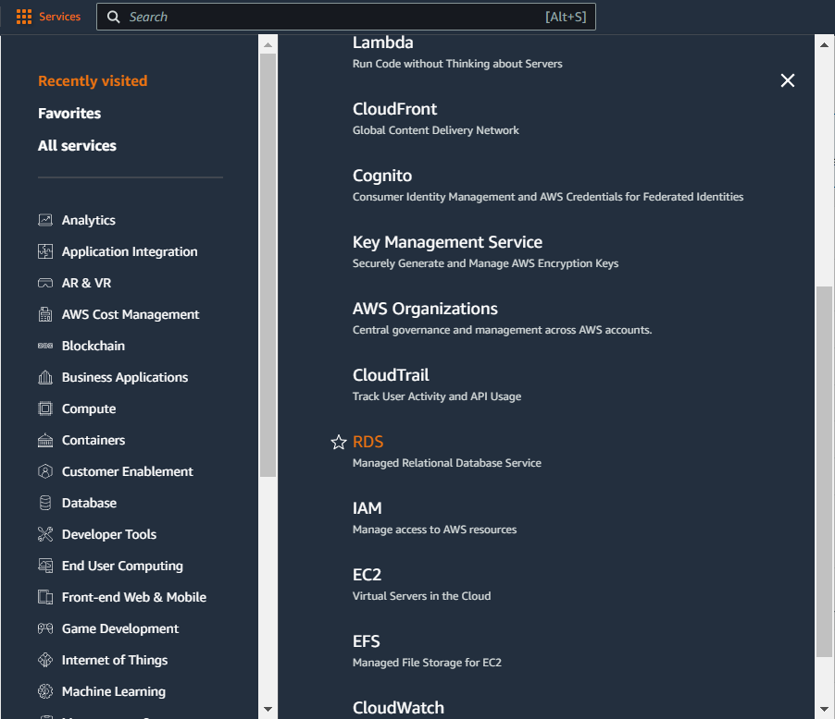
Select services and then click on rds button
Click on the Services button
Click on the RDS button

Slide 7
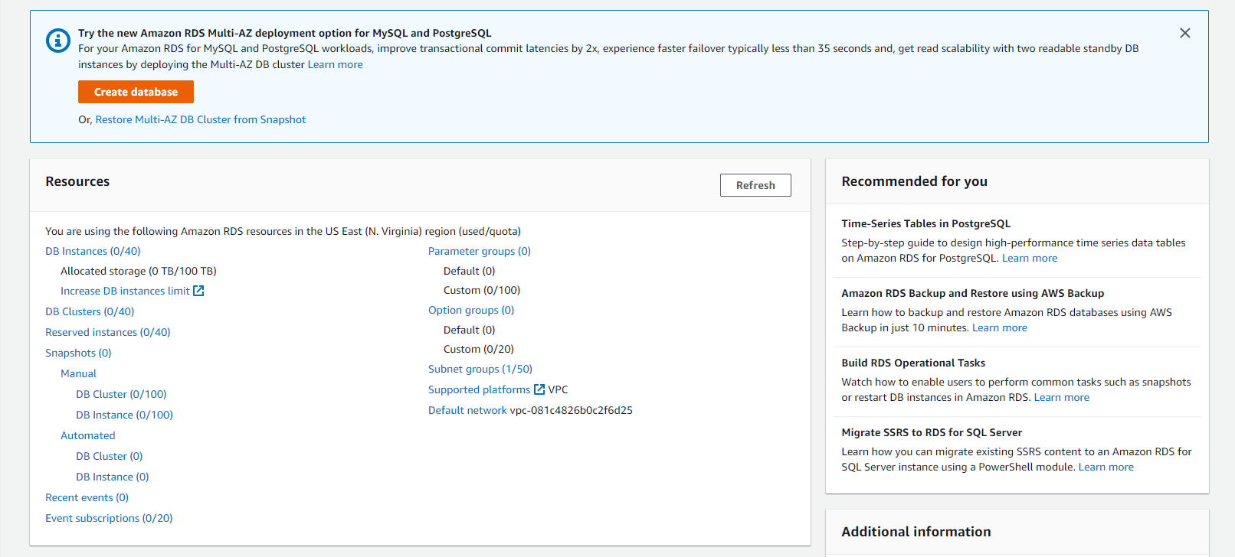
Click on create database button

Slide 8
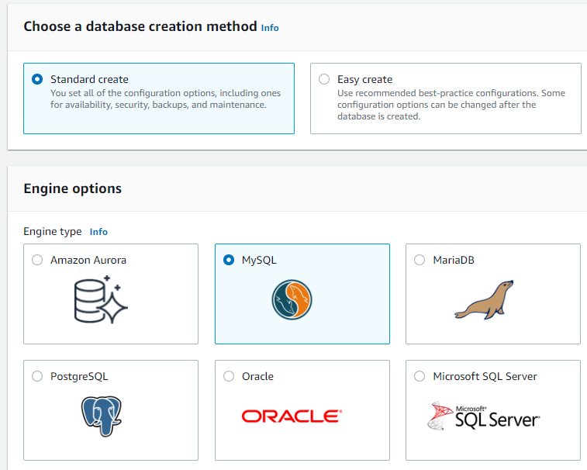
Choose standard create > select engine type as mysql

Slide 9
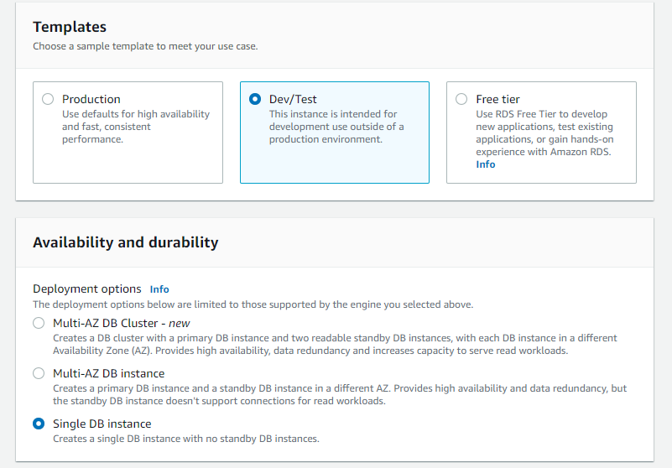
Choose template as dev/test and set the availability to single db

Slide 10
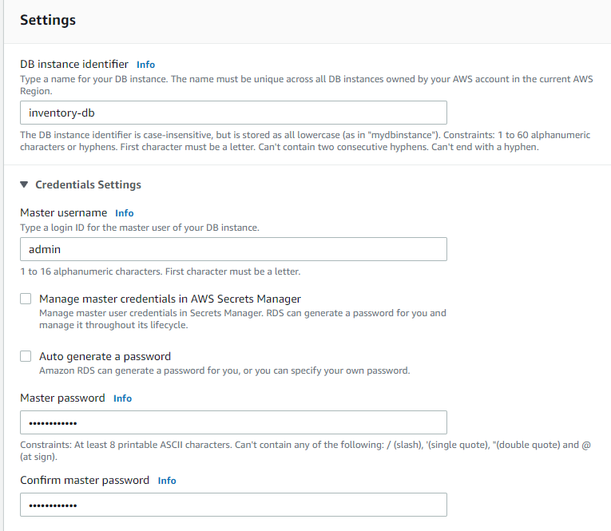
Update the settings as mentioned in the lab

Slide 11
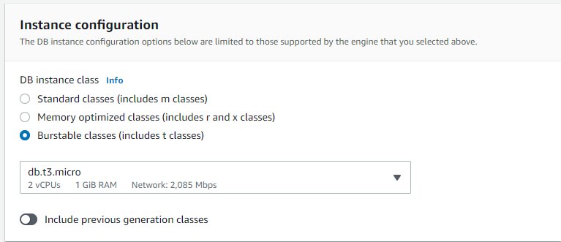
Update the instance configuration as shown

Slide 12
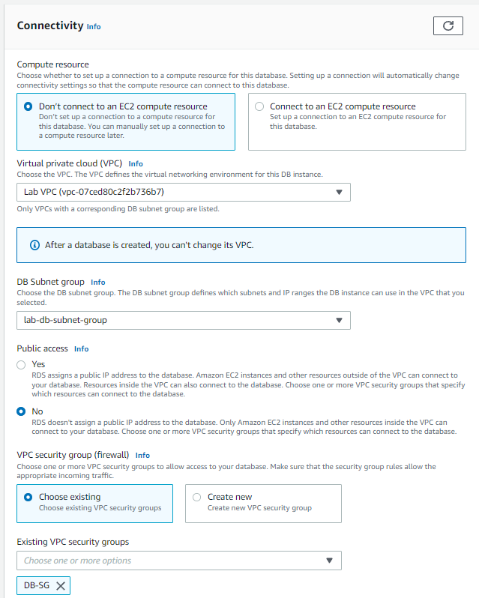
Update the connectivity settings as shown by updating the vpc and security groups, remove the default security group

Slide 13
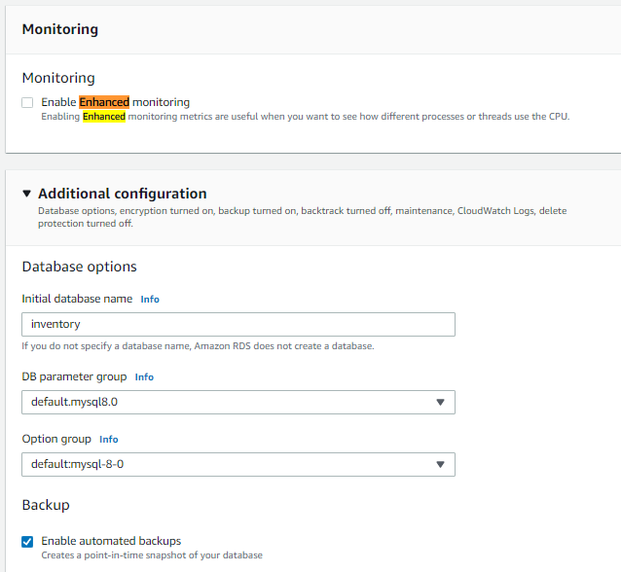
Uncheck enable enhanced monitoring checkbox and under additional configuration give the initial database name as inventory and then click on create database

Slide 14
Task 2 : Configuring web application communication with a database instance

Slide 15
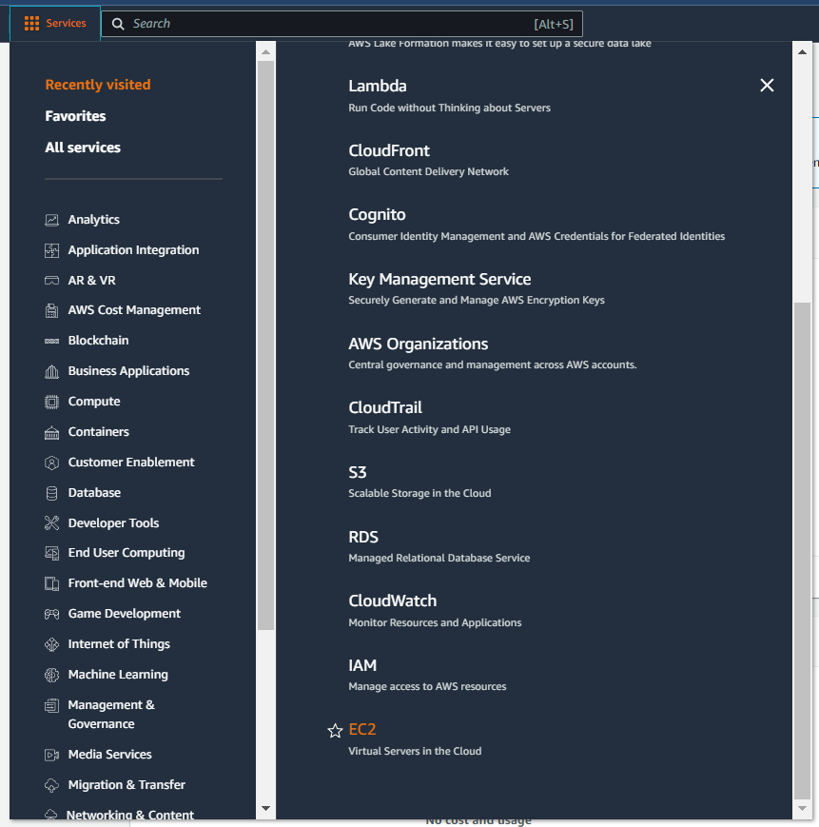
In the services menu select ec2

Slide 16
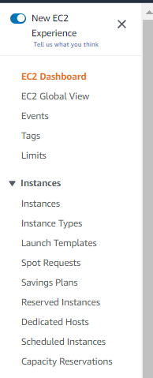
Click on instances in the navigation pane
Click on instances

Slide 17
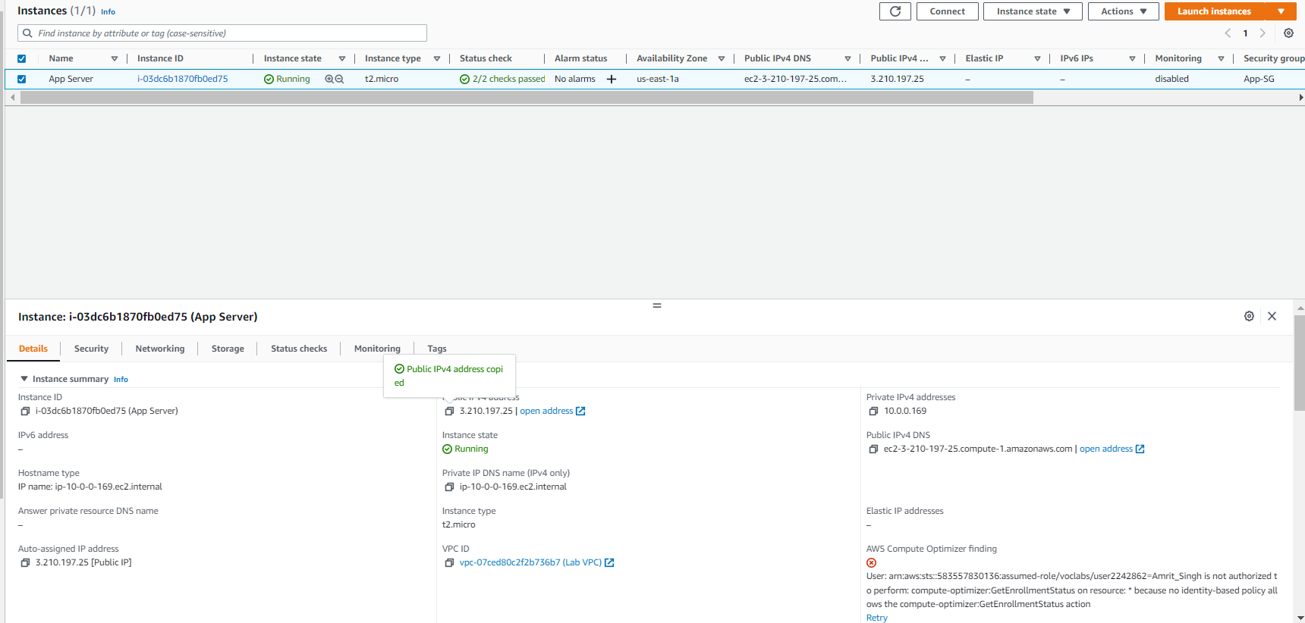
Copy the public ipv4 of the app server instance

Slide 18
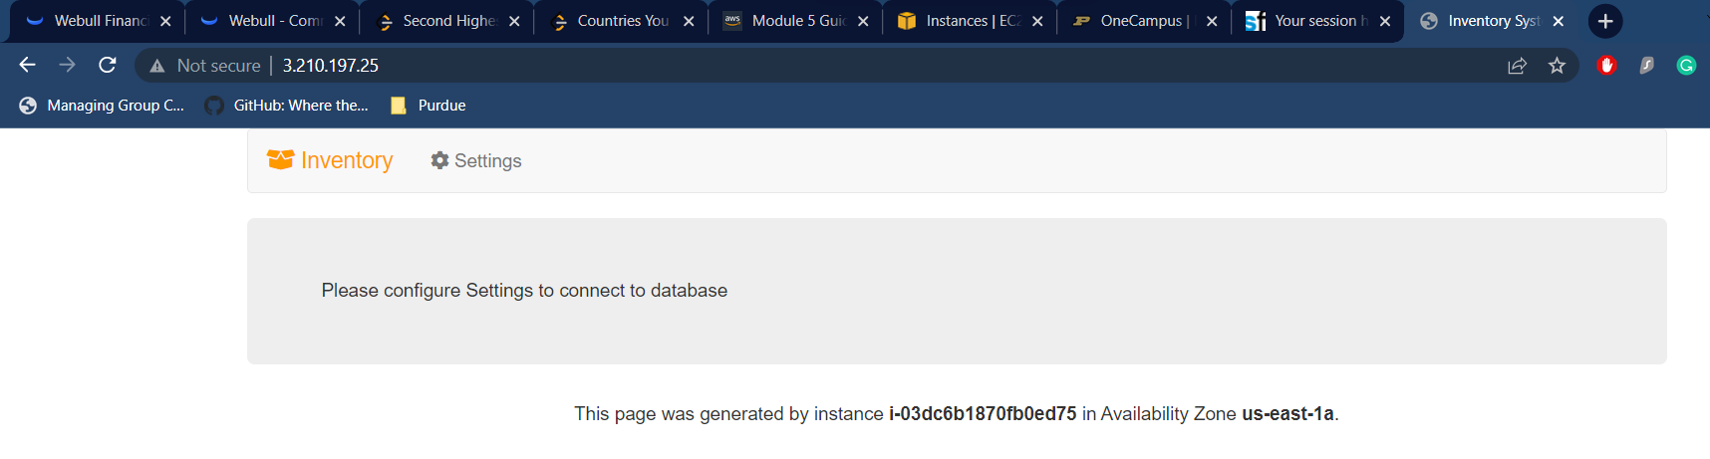
Copy the ipv4 address in a browser and click on settings

Slide 19
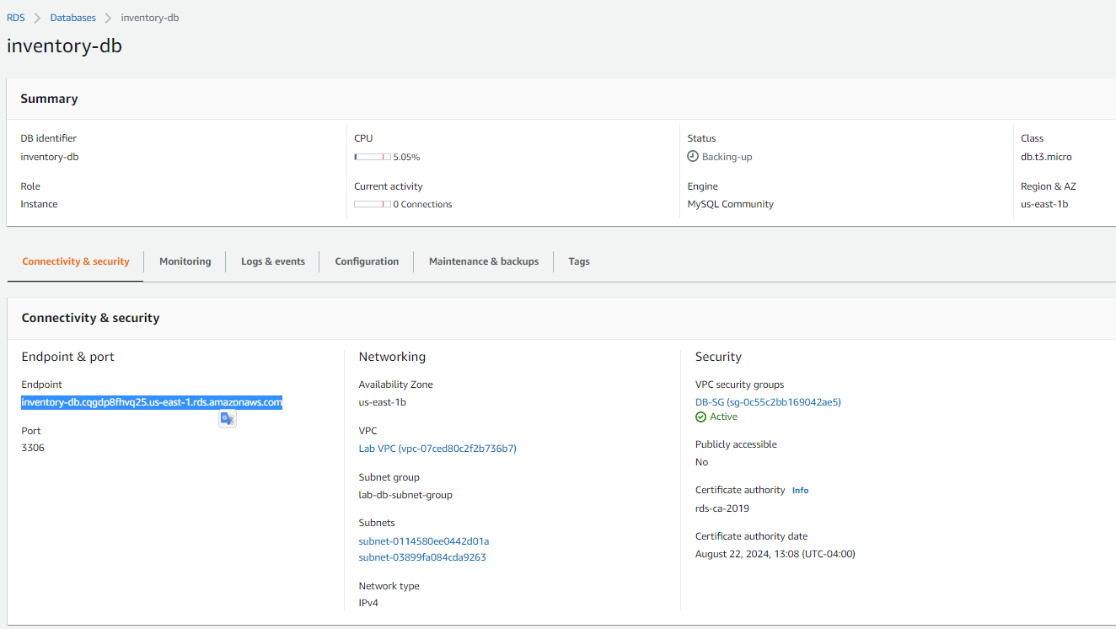
Go back to the rds page in aws and choose databases – inventory-db and copy the endpoint

Slide 20
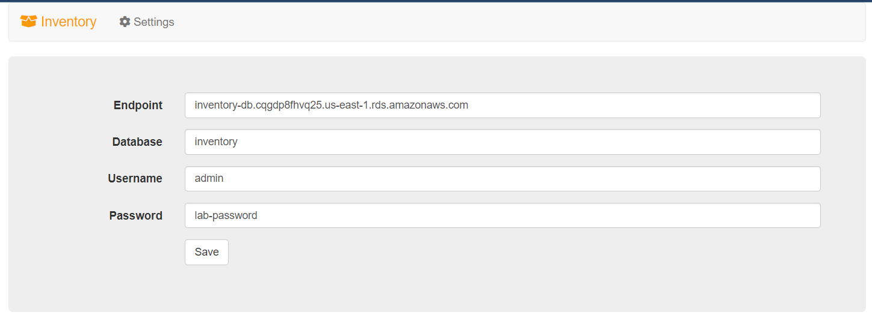
Paste the endpoint in the settings pane of the webpage that you opened earlier along with the details mentioned in the aws labs

Slide 21
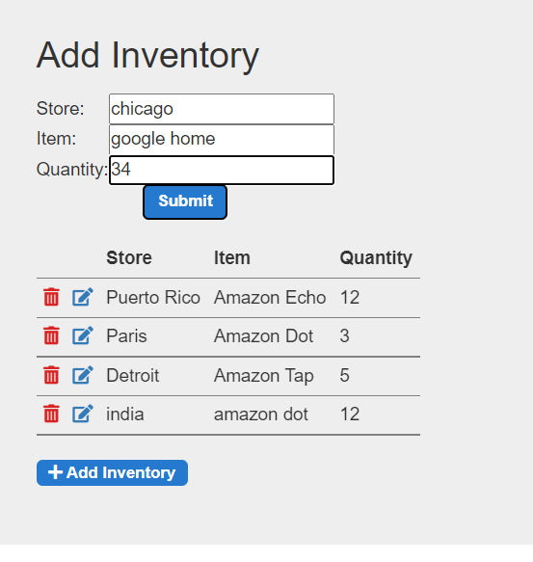
By clicking on add inventory you can add records to the RDS database, make sure to make atleast 5 records

Slide 22
THANK YOU
Amrit Singh

